Slide 1
Exploratory Data Analysis and optimum feature selection using R
Yash Singhal
Notes:
What is Data Any information which can be gathered Two products
What is Data Analysis : Data Analysis is the process of analyzing the data set so as find interesting relationship, patterns and to bind the findings that you have produced using concrete stastical proof while EDA is basically is just perfoming intial investigation on the dataset to find promising attributes, relationship , attributes so its just serves as the The first stages of the data analysis

Slide 2
Agenda
Following Topics are going to be covered in the following Talk
What is Explotary Data Analyis (EDA)
Common Types of Data
Common Forms of EDA
Importance of EDA in Machine Learning

Slide 3
Exploratory Data Analysis
Exploratory Data Analysis refers to the critical process of performing initial investigations on data so as to discover patterns,to spot anomalies,to test hypothesis and to check assumptions with the help of summary statistics and graphical representations.
In other words , it's a process to get familiar with the data set and facilitate further working
Usually performed after the data Wrangling portion and also considered one of the key steps in predictive modelling if that’s your end goal. However Typical usage of this process is to find insights with the data you have
Notes:
Notion of Data Set. Which features are more spread and which are Concentrated Remove Unnecessary Column
Data Wrangling – Cleaning and Preprocessng of data set

Slide 4
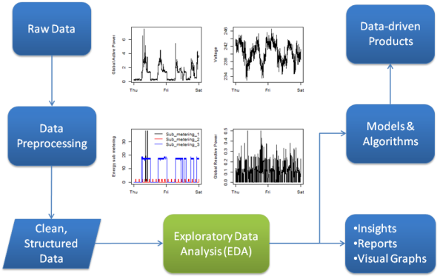

Slide 5
Exploratory Data Analysis
Usually starts with the Question “What you really want to achieve ?”. One example could be while working on the Titanic Dataset asking Whether age was instrumental in deciding if one survives in Titanic.
Supposed to Be dirty, quick and not meant for reporting. It’s basically your process to better acquaint yourself with data
Considered an Art and have no right answer. Better you find relationships between the attributes and get comfortable with your dataset easier would be the analysis or your working towards your end process
Usual operations include looking at the relationship between single attributes and response variables, relationships between the multiple attributes etc

Slide 6
Common Types of Data
Categorical : Have no statistical significance and is merely a way to represent different items. Ex Different Hair Colors, Blood group of Person. Mean mode and other statistical measure does not make any strength
Ordinal: Similar to Categorical but with an implied Ordering. For example the grades obtained in the Scholar while indeed Categorical but have an ordering
Quantitative Attributes: Numerical Features on which statistical tools can be applied and make sense. They in effect represent True numbers
Notes:
Categorical How would Male and Female
Ordinal A+ A B+

Slide 7
Common forms of EDA
Univariate Analysis: This involves looking at the features or attributes one at a time to gain better understanding of your Data set. Typical usage include looking at the descriptive measures like spread, central tendency to gain better understanding which attributes might be instrumental in answering your end goal. After this process you will have a set of important attributes for further analysis
Multivariate Analysis: This involves taking the above set of attributes and doing analysis taking two or more at a time (Usually Two). This step usually involves identifying relationship for instance between the pair of feature, or most commonly identifying relationship between a attribute and a response variable
Always Perform univariate data analysis before multivariate.
Notes:
Univarate Elimatiion : Promising Attrbutes

Slide 8
Looking at the Data
There are two ways of looking at the data in EDA
Non- Graphical : Provides the concrete statistical summary of your attributes. Generally not that much useful as Humans are not often great at interpreting these number particularly in large datasets. Nevertheless they might be useful in proving whether your gut feeling is misplaced
Graphical : Diagrammatic Summarization of your attributes. Combined with the well drawn plots , it provides a wealth of information. It is also possible through plot to interpret data easily in 3 dimension like for instance analysis of two quantitative and one response variable which is not that much feasible in Non graphical
Notes:
Non Graphican and Graphical Complement each other

Slide 9
Summarization
Univariate Non graphical EDA
Univariate graphical EDA
Multivariate Non graphical EDA
Multivariate graphical EDA

Slide 10
Notebook

Slide 11
Importance of EDA in feature Selection
Check the distribution and spread of the individual attributes for predictive modelling. A attribute which have a larger spread might give poor performance and need some form of data transformation to avoid dominance by that attribute
Response Variable in which no of observations of one Category is much greater than the other might lead to the class Imbalance and thus need some undersampling or oversampling
Ordinal Variable and Categorical Variables should be handled with care. One hot encoding for pure categorical variable
Relationship between the two quantitative attributes might be important.While we do want to keep the features where attribute is correlated with response variable . We might want to keep out the attributes which are highly correlated with another attribute to avoid Redundancy and possible performance loss (ie Regression)

Slide 12
Questions
Contact me at
yashgyy@gmail.com
linkedin.com/yashsinghaldev
Follow on twitter @yashgyy

